Slide 1
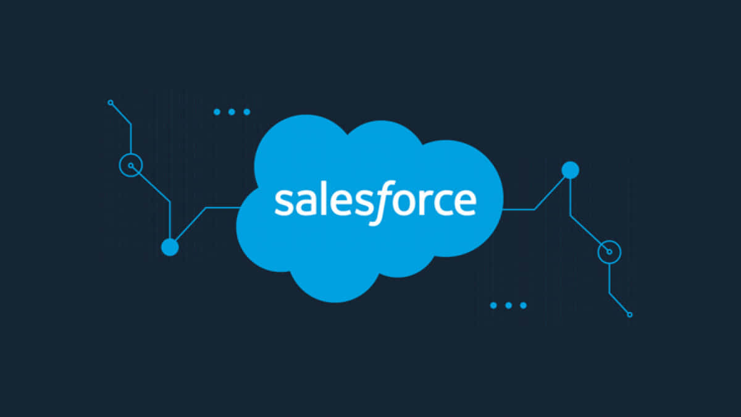

Property management application using
long term internship project

Slide 2
Team details
COLLEGE NAME: DR. LANKAPALLI BULLAYYACOLLEGE
TEAM LEAD: KILUM.ARUN DURGA PRASAD
TEAM MEMBERS: RAIHAN MOHAMMED HUSSAN MERAPALA YUVARAJU
ROKKAM VISHNU
TEAM ID: LTVIP2025TMID24144

Slide 3
INTRODUCTION TO SALES FORCE
Sales Force Is A Customer Success Platform Designed To Help
Sell, buy, Service, Market Analyze And Connect With Customer.
Sales Force Is A Application That You Can Run Your Business From
Any Where. Using Standard Products And Features. You Can Manage Your Relationships With Prospective Customers And Existing Customers. We can also make good communication,
Collabrate, Engage With Employees And Partners. Also, Store Your Data Securely In The Cloud.

Slide 4
PROJECT DISCRIPTION:
Develop an app of the property management where buyer can order has requirement and get the appropiate details of the property according to his interest just provide him with some discounts upto what extend he can get the discount also track whether he is interested in taking the loan available.So just calculate how much loan amount the user can get it provide the security for two different profiles like for marketing and sales team. Then finally create the reports and dashboards so there will be a clear view. Just get the reports on the count of loan passed getting the property purchased close to the deal.

Slide 5
Steps to create a salesforce account
Go to salesforce .com
Cilck to sign up
Enter your address
Click the linked e-mail you receive
Set a password for you account
Log in with your username and password.

Slide 6
Steps to create salesforce developer account
Go the developer. Salesforce.com
Click to sign up
Enter your email address
Click the link in the email you receive
Set a password to your account.

Slide 7
Objects in salesforce
In sales force objects are essentially database tables
That permit you store data that is specific to organisation.
There are two different types of objects in sales force.
1.Standard object.
2.Custom object.
1.Standard object: standard objects are the kind of objects
That are provided by sales force. Com such as contracts,
Users, reports, dashboards etc.

Slide 8
2.Custom object: custom objects are the kind of
Objects that are created by the users.
They Supply information that is unique and essentional
To their user . They are the main source of any application
And provide a structure for sharing data.
In property management we create a custom object
Of three types:
Property object.
enquiry object.
Loan object.

Slide 9
1.To create property object: enter the plural name as
Properties label name (property). And record name
(property name) and click on the allow reports. Allow
Search and save is automatically the object is created.
2.to create a enquiry object: enter the label name is
(lead) plural label name(leads)record name(customer
Name). Click on allow reports. Allow search and save
it automatically the object is created.
3. To create a loan object: enter the label name (loan)
Plural label name (loans). Id data type as auto number
Display format as (00,00), starting number (0001).
Click on the allow reports allow for search and save it.

Slide 10
Tabs
A tab is like a user interface that is used to build a
Records for objects and to view the objects.
Type of tabs:
Custom object tab.
Web tab.
Visual force tab.
The lightning app
A lightning app is a collection of items that work by
Together to serve a particular function. In lightning
Experience, lightning apps give your users acces to the
Set of objects, tabs, and other items all in convenient
Bundle in the navigation bar.

Slide 11
Lightning apps let you brand your apps either custom
Colour and logo. You can even include a utility bar and
Members of your organization can work more better
Efficient by easily switching between apps.
To create a property management app
Fill the name as an property management in app
Details and branding next (app option page)keep it as
default. click on next.
2.(utility items) keep it as default-next –(add user.
Profile) add system administrator in sales force user
Platform and standard user-next.

Slide 12
3.To add navigation items in that app enquiries, loan,
Property, report, dashboard. select the items from the
Search bar and move it by using the arrow button and
Click on the next.
4.To add user profiles go the system administration in
Sales force platform user standard user and search
Profiles in search bar click on the arrow button and
Save it.
In lightning app all details about the property will be
Added.

Slide 13
Fields
Fields represent the data stored in the columns of a
Relational database. It can also held any valuable
Information that you require for a specific object.
Hence the overall searching, editing of the records
Became simpler and quicker.
Types of fields:
Standard field: the standard field are predefined
Fields in sales force that perform a standard task.
The main advantage of that you cannot simply delete
A standard field until it is a non-required standard
Field.

Slide 14
Otherwise, users have the option to delete them at
Any point from the application freely.
Moreover, we have some fields that you will find a
Common in every sales force application. There are
Created by consumer last modified.
b) Custom object: custom objects are highly flexible
And users can change them according to their use and
Requirements. Moreover, each organizer or company
Can use them if necessary. It means you need to not
Always included them in the records, unlike standard
Fields. Hence the final decision depends on the user,
And he can add/remove custom fields of any given
Form.

Slide 15
In property management we are created a different
Fields:
1.Create a enquiry object field: fill the field label and
Name, lead number, data type (auto number) click on
Next and save it.
Lead type: create the picklist fields by the values (buy , rent)
State: create the picklist fields (maharastra, gujarat, rajasthan)
City: create the picklist fields (nashik ,surat ,jaipur )
Email : create the email select the data types as email (e-mal)
Phone: select the field data type as (phone)

Slide 16
2.Create picklist field on enquiry object:click new and select picklist fields next and enter label name (state) and select enter values option (maharastra, gujarat ,rajasthan)next and save
note: we create picklist fields for city follow the above steps just change the labels and values.
create field dependency (on enquiry objects)
select the state as the controlling fields and select city as the dependent field. Click continue select the appropirate value in each column by double clicking them click include values. And it is also same for Gujarat and Rajastan with its city. Click preview than test the dependency by selecting different state and viewing the associate values available for particular state.

Slide 17
3. Create the property objects field :
A) customer name lookup relationship related to leads select the formula in field date type. In formula option option select advanced formula and write the following formula.
lead ID, customer name
B) create property type : (pick list fields)
C) Residential picklist fields
( Fields dependency)
D) Commercial picklist fields
( Field dependency)

Slide 18
E) Industrial picklist fields
( Fields dependency)
Note: In above picklist fields property type is contral field and residential commercial industrial is dependent field
F) Create the picklist field ( Maharastra, Gujarat, Rajasthan)
( Fields Dependency)
G) City ( Take any city for field dependency)
Note: In the above picklist fields state is a control fields and city is dependent filed

Slide 19
H)Discount :( percentage as the field data type)
I) Price: ( Number as the field data type)
J) Loan Amount: ( Currency as the field data type)
4) Create the loan objects field :
A) property name: ( Lookup relationship related to property)
B) Customer name:( Lookup relationship related to
enquiry)
C) Interest rate: ( select the field data type as currency)
D) Term: (select the field data type as number)
E) Annual loan: Field create the number as the field data type.
F) Total loan installment: (Field create the number as the
Field data type)

Slide 20
g) Loan repayment: ( field create the number as the
Field data type)
h) Loan amount: (select the field data type as formula)
Go to the fields and relationship and select the formula in field data type in the formula option
Select advanced formula and write the following.
Formula
(loan repayment-c*(((1+(interest-rate-c/52))^term-
c)-1))’((interest-rate-c/32)*((1+(interest rate-c/52))^
Term-c))

Slide 21
Check the syntax below whether the formula syntax
Is correct or not.
Page layout and record type : page layout in salesforce
Allows us to customize the design and organisation of
Detail and edit pages of records in sales force.
Page layouts can be used to control the appearance
Of fields, related lists, and custom links on standard
And custom object detail and edit pages.
Record types in salesforce allow you to have different
Business process,picklist values,and page layout to a
Different uses based on profile.

Slide 22
Create page layout for property object
rent page layout- create another page layout name as (rent) and remove the discount and loan amount fields from the rent page layout.
Record type for property object- enter the record type label as (buy) and select active check box next and save.
page layout assignment- select the buy record time and select the page layout to use (buy) then click on the save.

Slide 23
Profile
A profile is a group/collection of settings and permission that define what a buyer can do in salesforce profiles. control object permission,field permissions, user permissions ,tab settings ,app seetings ,apex class access, visual force page access,page layouts,record types,login hours of login IP ranges you can define profiles by the users job function for example system administrator developer sales representative.
Types of profiles in sales force:

Slide 24
Standard profiles: by default salesforce provide below standard profiles. We cannot deleted standard once each of these standard one includes a default set of permissions for all of the standard objects available on the platform.
Custom profiles: custom once defined by us they can be deleted if there are no uses assigned with particular one.
1) sales manager profiles: clone the desired profile (standard user is preferable) scroll down to custom object permissions and give view all access permissions for lead and property loan and sale (sales manager also having create edit delete for lead property loan objects) clone profile (standard platform user) for below all profiles
A)marketing executive profiles
B)marketing manager profiles

Slide 25
2) Marketing Executive Profile:
In the profile level give read and create access for lead property, loan objects to marketing executive profile and read, create, edit. Delete for the marketing manager profile for lead, property, loan objects.
3) Marketing Manager Profile:
Should have access to marketing executive profile.
4) Sales Executive Profile:
Follow the steps to create the profile just to change the name for below profiles clone profile
( Standard Platform User) profile name ( Sales Executive Profile) and assign a sales permission set.
For Sales Rep-1 -> Read, Create, Edit for lead, property and loan objects.

Slide 26
For Sales Rep -2 -> Read only
NOTE: Above 2 are permission set and assign a permission set according to user need. We will discuss I net milestone.
user
A user is anyone who logs in to Sales force users are employees at your company such as sales reps, managers, and IT specialists, who need access to the company’s records every user in sales force has a user account. The user account identifies the user and the user account settings determine what features and records the user can access.
NOTE: As Sales force license can only be used by 2 users at a time in data so if you don’t find sales force license then deactivate a user who has sales force license or change the license type from sales force to any other

Slide 27
To Create user:
1.First name
2.Last name
3.Email
4.User name
5.Nick name
6.Role
7.User license
8.Profiles
These details are required to create a user

Slide 28
Permission set
A permission set is a collection of settings and permissions that gave users to access various tools and functions.
Permission sets extend users functional access without changing their profiles.
Steps to create a permission sets:
1.Create permission set
2.Select the object settings.
3.Search object property
4.Click on edit option.

Slide 29
In object permission we give view all permissions and click to save button all these steps are also used to create the loan and enquiry object also.
After saving the permission click to manage assignment.
Now click on the add assignment and add user name.
Set up for organization wide (owd)
In sales force owd is a settings that controls the defaults access level for records in an object.
finally these are four levels of access that can used be set in sales force owd and they are:

Slide 30
User adoption
Create view and delete a records for loans
report: reports give you access to your sales force data you can examine your sales force data in almost infinite combinations display it is easy to understand formulas and share the resulting insights with other objects . Before buliding reading and sharing reports review these reporting basics.
Types of reports in salesforce:
Tabular
summary

Slide 31
3) Matrix
4)Joined reports
Create report: select report type from category or from report type pannel or from search pannel (properties with customer name) click on start report customise your report. Add fields like property name customer name,city property type etc.click on save and run (properties with customer name and report) create report for following conditions create report for the total number of loan passed for getting the amount for the property.

Slide 32
Dashboards
Dashboards help you visually understand change in business conditions so we can make decisions based on the real time data you gathered with reports. Use dashboards to help users to help identify trends sort out quantities and measure their impacts on their activities. Before building and sharing dashboards review the dashboard basic.
Create dashboards: name the properties with customer name report and click component.
Create a dashboard for chat and display app on the home page

Slide 33
1.Public read/ write / transfer (only available leads and cases)
2.Public read/write
3.Public read/ only
4. Private
Click edit in the organization- wide defaults area.
For each objects select the defaults access you want to give everyone.
To disable automatic access using your hierarchies deseclect grant access using hierarchies for enquiry, property custom object.
Click edit and from the drop down select private for internal and external.

Slide 34
Flows fall into five categories: Screen Flows Schedule-Triggered Flows Auto launched Flows Record-Triggered Flows Platform Event-Triggered Flows
Classic Email Template ->
A. Note:
For creating this flow you have to create the Due date for Loan Payment field in the loan object with date and time field data type Page
B. Search for the Classic Email Template • Click on the New Template-› name-> Loan Amount Pay Reminder
C. Author as the System admin user-› give Description Reminder Calls through emails
Clone that Email Template and follow the steps which is mentioned above and give the following names you have to clone it multiple times that template
Loan Amount pay Reminder for 24 hrs
Overdue by one day
Overdue

Slide 35
select the email template which you have created for 24 hours There Click on the New Email alerts....> and give the name as Email For the 24 hrs before select the email template which you have created for the 24 hrs before and recipient for all condition is owner
E. Follow the Above steps and create the Following Email Alert by cloning with the Similar steps Loan Amount Pay Reminder(Cloned Email Alert)Overdue by one day(Cloned Email Alert)Overdue(Cloned Email Alert)
Create Flows ->
Click on the Record Trigger Flow
Select the 19.80mc object-> Trigger the Flow When..> A Record is created or updated
Condition Requirement All Conditions are met (AND) ..-> Field......
›Due Date For the Loan Payment Opscotor as -->is Null value False Click on the Schedule path.> Path Label as-›within 1 Day....>

Slide 36
Go to the layouts change the auto layout with the free for delete both the thread for each decision and create one new connection thread similarly do for all threads and come back to auto layout4. Create the record to test the flow* APEX Triggers - Apex can be involved by using triggers. Apex triggers enable you to perform custom actions before or after changes to Sales force records, such as insertions, updates, or A trigger is Apex code that executes before of after the following types of operation selections.

Slide 37
With these a property management application using
Sales force was completed with creation of lightning
App of property management.

